Slide 1

Frontend course session 2 first CSS code
Created by Ahmed Samir

Slide 2

Agenda
Meta tags
What is css
Bref history
Where I can write CSS code
How to write CSS code syntax
Background color and color properties
Background image property
Padding and margin properties
Border property
What is difference between inline element and block elements
Tasks

Slide 3
Meta tags
Purpose | Example
Character encoding | <meta charset="UTF-8">Ensures all languages/symbols display correctly
Page description | <meta name="description" content="Free tutorials on HTML and CSS">
Keywords | <meta name="keywords" content="HTML, CSS, web development"> (Not widely used anymore)
Author | <meta name="author" content="Ahmed Samir">
Viewport (Responsive) | <meta name="viewport" content="width=device-width, initial-scale=1.0">
Refresh / Redirect | <meta http-equiv="refresh" content="5;url=https://example.com">
Robots (SEO control) | <meta name="robots" content="index, follow">

Slide 4
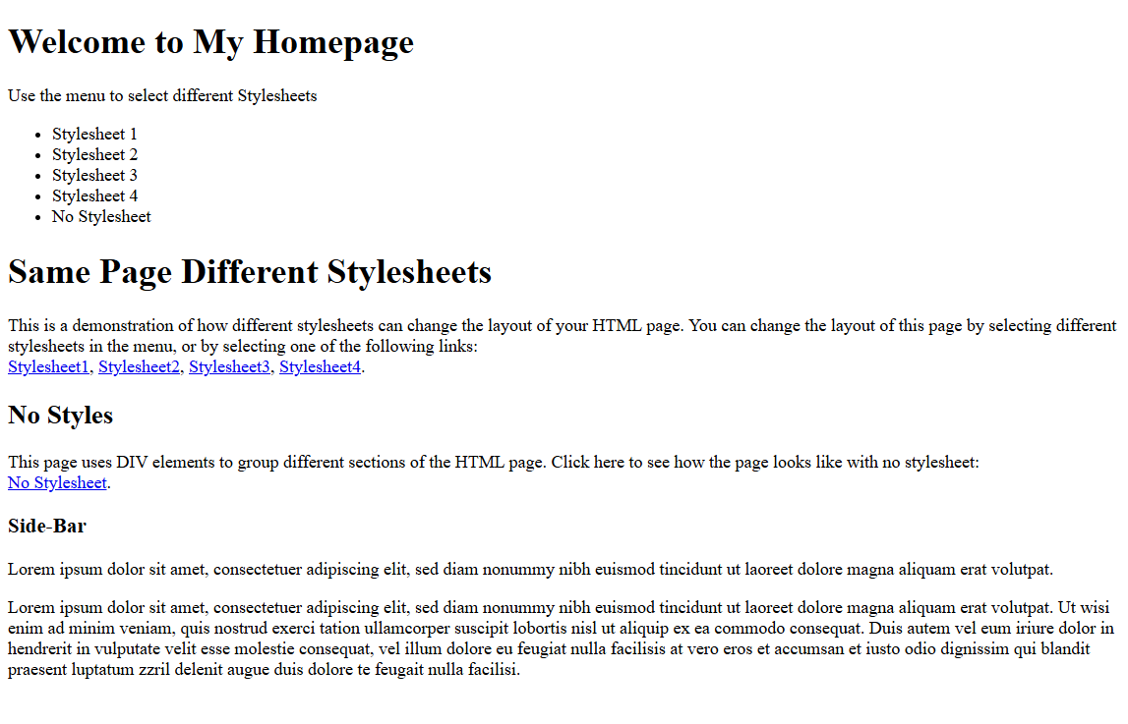
What is CSS
CSS (Cascading Style Sheets) is the language used to style HTML elements. It controls colors, fonts, spacing, layout, and more.
HTML ONLY :

Slide 5
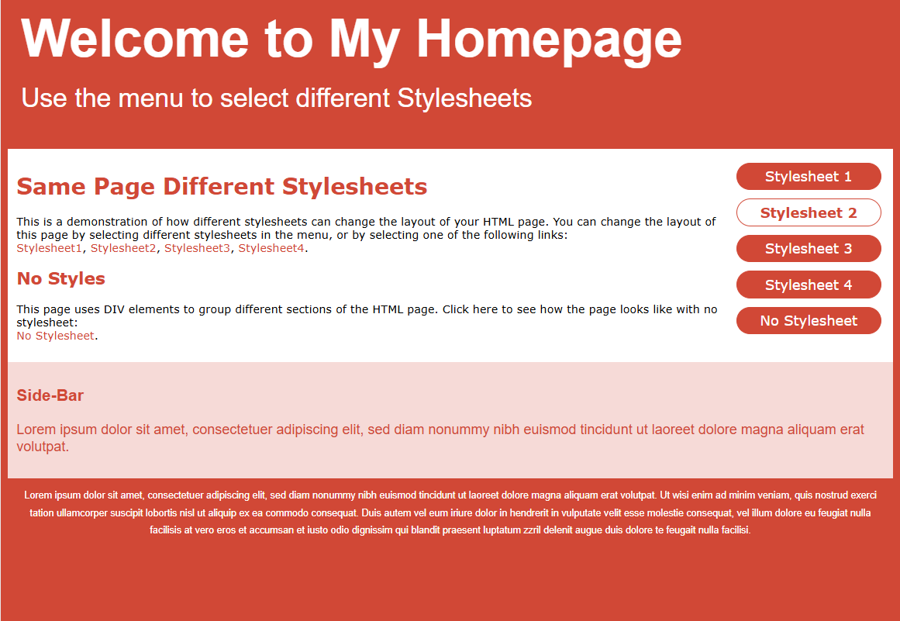
What is CSS
HTML & CSS

Slide 6
What is css
CSS was created by Håkon Wium Lie in 1994, while working with Tim Berners-Lee (the inventor of the Web) at CERN.
Håkon published the first proposal for CSS in October 1994.
It became an official W3C (World Wide Web Consortium) standard in 1996.
Why?
In the early days, HTML had no proper way to style websites. All fonts, colors, and layout were handled inside HTML using messy tags like <font>. CSS was invented to separate content (HTML) from style (CSS) and make websites easier to build and maintain.
https://youtu.be/Z4pCqK-V_Wo?si=v_EUY6St5xa-M1xr
A brief history of CSS until 2016

Slide 7
A brief history of CSS until 2016
CSS Origins (1994)
Håkon Wium Lie, working at CERN, proposed CSS in 1994.
At the time, there was no standard way to style web pages.
Early browsers like Viola had their own styling systems, but no unified language existed.
Web authors wanted more control over design, like changing fonts and layout.
CSS Proposal and Early Support
Håkon published the first CSS draft just before Netscape released its new browser.
Bert Bos, creator of the Argo browser (which also supported styles), joined Håkon to refine CSS.
CSS was designed to be simple, declarative, and not a programming language.
Author vs. User Control Debate
One core CSS idea: a balance between author styles, user preferences, and device capabilities.
This “cascading” concept set CSS apart from other proposals like DSSSL or browser-specific solutions.

Slide 8
A brief history of CSS until 2016
W3C Involvement
In 1995, W3C started supporting CSS development.
CSS1 became an official W3C Recommendation in December 1996.
In 1997, the CSS Working Group was created, chaired by Chris Lilley.
CSS2 was released in 1998, introducing more features.
Browser Adoption
Internet Explorer 3 (1996): First to support CSS (partially).
Netscape Navigator 4: Poor, inconsistent CSS support.
Opera: Strong early support for CSS1.
Safari (2003): Based on Konqueror; later became a major CSS player.
Mozilla/Firefox: Built after Netscape open-sourced its code; heavily invested in standards.
Apple and Microsoft had separate approaches, with Mac IE showing strong CSS compliance at one point.

Slide 9
A brief history of CSS until 2016
Web Fonts
CSS2 included Web Fonts, but adoption was slow due to licensing and tech issues.
Microsoft’s EOT format was proprietary and not widely adopted.
Around 2008, WOFF (Web Open Font Format) emerged as the new standard.
Beyond Browsers
CSS began being used in e-books (EPUB) and PDF formatting (e.g., with Prince).
Used in mobile rendering and later in GUI design.
Test suites by people like Eric Meyer, Todd Fahrner (Acid Test), and Gérard Talbot helped improve implementation quality.

Slide 10
A brief history of CSS until 2016
Widespread Use and Growth
By 2016, CSS had over 60 modules, with wide use in web, publishing, and apps.
Used in millions of websites, with numerous fonts, services (like Google Fonts), and books dedicated to it.
Expected to eventually be replaced, but still going strong at 21 years old.
https://www.w3.org/Style/CSS20/history.html

Slide 11

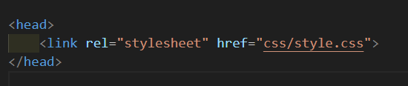
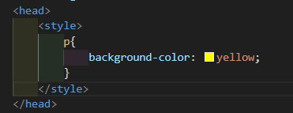
Where I can write CSS code
External file
Internal the file

Slide 12

Where I can write CSS code
Inline element with style attribute
How to Write CSS Code (Syntax)?
selector {
property: value;
}
Example:
p {
color: red; font-size: 16px;
}

Slide 13
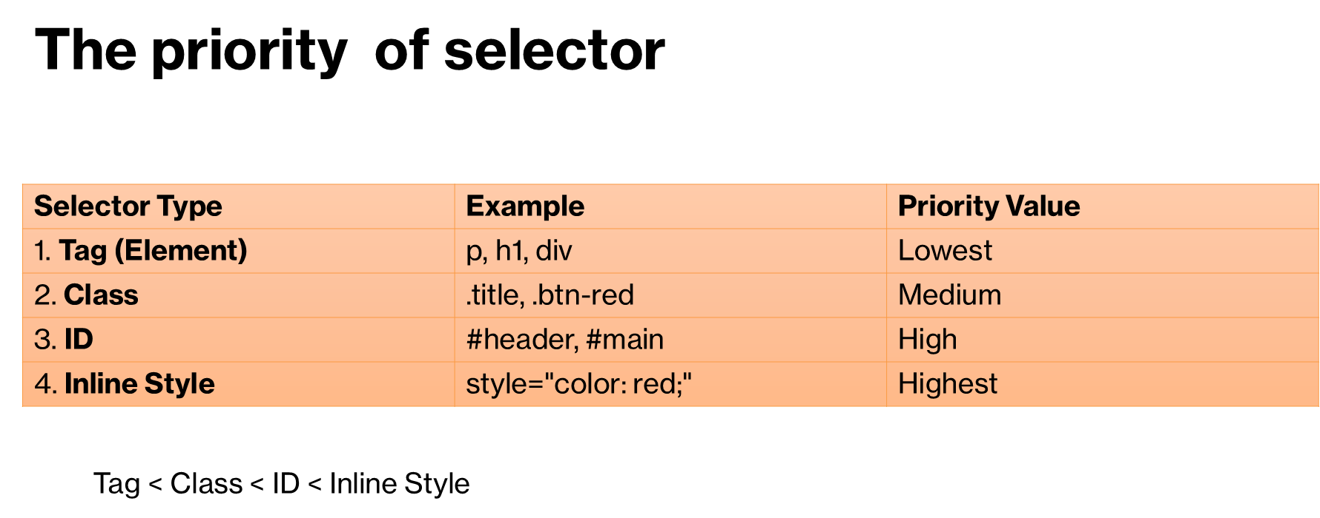
Basic of selectors
Id: #id_name example #test{color:red}
Classes: .id_name example: .container{padding:20px}
Tags: tag_name example: p{color:red}

Slide 14
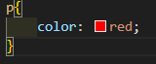

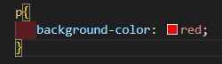
How to use color
Color property
Background-color property

Slide 15
How to assign color value
Color Names
There are 147 standard color names like green, orange, teal, tomato, etc.
HEX Codes (Hexadecimal)
Start with # and use 6 digits.
What Is Hexadecimal?
Hexadecimal is a base-16 number system.
That means it uses 16 digits instead of 10 (like the decimal system you're used to)
Digits in Hexadecimal:
1, 2, 3, 4, 5, 6, 7, 8, 9, A, B, C, D, E, F
color: #FF0000; /* red */
background-color: #00FF00; /* green */
RGB (Red, Green, Blue)
RGB stands for:
R → Red
G → Green
B → Blue
rgb(255, 0, 0) = Full Red, no green or blue.
rgb(0, 255, 0) = Full Green
rgb(0, 0, 255) = Full Blue
rgb(255, 255, 0) = Red + Green = Yellow
rgb(255, 255, 255) = White (all full)
rgb(0, 0, 0) = Black (all zero)

Slide 16

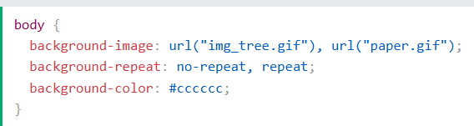
Background image property
The background-image property sets one or more background images for an element.
By default, a background-image is placed at the top-left corner of an element, and repeated both vertically and horizontally.

Slide 17
Background image property
Value Type | Example | Description
url() | url("image.jpg") | Loads an image file
none | none | Removes background image
linear-gradient() | linear-gradient(to right, red, blue) | Smooth horizontal/vertical gradient
radial-gradient() | radial-gradient(circle, red, yellow) | Circular gradient
conic-gradient() | conic-gradient(from 0deg, red, yellow, blue) | Angular gradient
image-set() | image-set(url("1x.jpg") 1x, url("2x.jpg") 2x) | For responsive/high-DPI images
Multiple images | url("bg1.jpg"), url("bg2.jpg") | Layers multiple images

Slide 18


Background image property
background-size: auto (Default)
The image keeps its original size.
It won't scale to fit the element.
If the image is bigger than the container → it overflows or gets cut.
If the image is smaller → you may see blank space.
Think of it like pasting a sticker on a wall — the sticker size doesn’t change.
background-size: auto;
background-size: contain
The image is resized to fit inside the element.
It scales proportionally (no stretch).
It may leave empty space if the aspect ratio doesn’t match the container.
Think of it like putting a picture inside a frame — it resizes to fit fully without cutting anything.
background-size: contain;

Slide 19

Background image property
background-size: cover
Fills the entire area of the element.
Maintains the image’s aspect ratio (not stretched).
Crops parts of the image if needed to make it fit.
background-size: cover;

Slide 20
Background image property
background-repeat
It controls how a background image repeats (or not) across the element’s background area.
background-repeat: value;

Slide 21
Background image property background-repeat
Value | What It Does
repeat | Repeats the image both horizontally and vertically (default).
no-repeat | Shows the image once only.
repeat-x | Repeats the image horizontally only.
repeat-y | Repeats the image vertically only.
space | Repeats the image with even spacing, no cropping.
round | Resizes the image so it fits whole number of times.
inherit | Inherits value from parent.
initial | Resets to default (repeat).
unset | Resets based on inheritance rules.

Slide 22
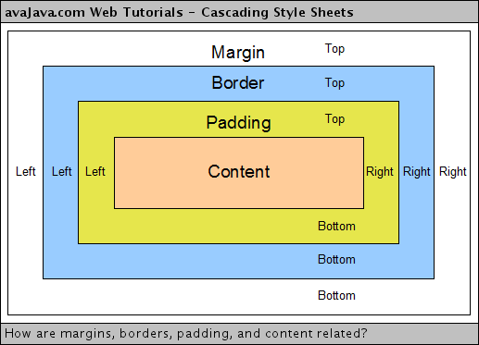
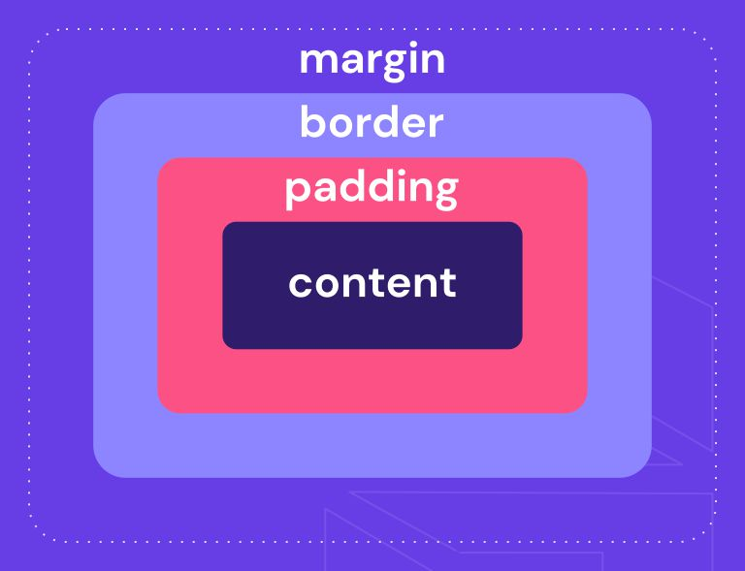
Padding and margin

Slide 23
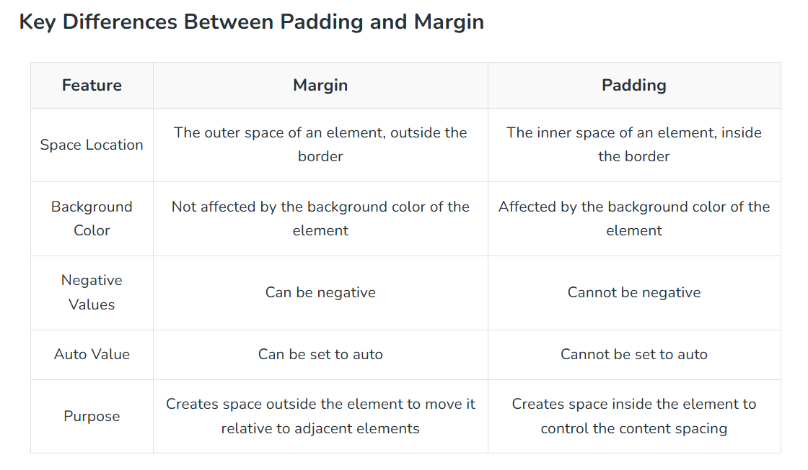
Padding and margin

Slide 24
Padding and margin
Padding: Adds space inside the element, between content and border.
Margin: Adds space outside the element, between elements.
Single Value
Two Values
padding: 10px; /* all sides (top, right, bottom, left) */
margin: 20px;
padding: 10px 20px;
/* 10px → top & bottom, 20px → right & left */
margin: 5px auto;
/* 5px → top & bottom, auto → center horizontally */

Slide 25
Padding and margin
Padding: Adds space inside the element, between content and border.
Margin: Adds space outside the element, between elements.
Three Values
Four Values
padding: 10px 15px 20px;
/* top: 10px, right & left: 15px, bottom: 20px */
margin: 10px 15px 20px 25px;
/* top: 10px, right: 15px, bottom: 20px, left: 25px */

Slide 26
Padding and margin
Padding: Adds space inside the element, between content and border.
Margin: Adds space outside the element, between elements.
Individual Sides
padding-top: 10px;
padding-right: 15px;
padding-bottom: 20px;
padding-left: 25px;
margin-left: auto; /* e.g., centering */

Slide 27
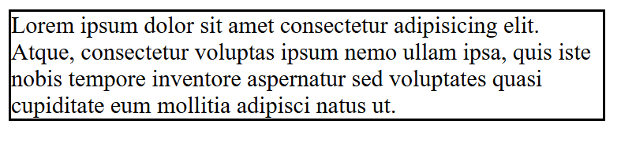
Border property
Basic syntax:-
selector {
border: width style color;
}
Example:-
div {
border: 2px solid black;
}

Slide 28
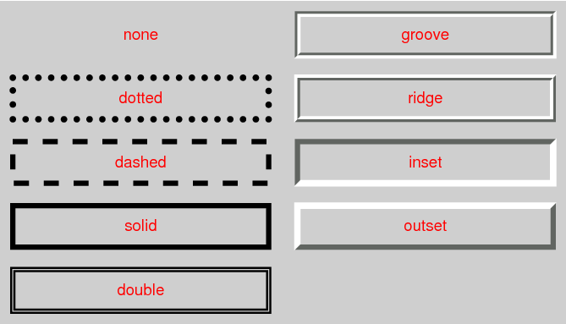
Border property
border-style:

Slide 29
Border property
You can remove a border with:
border: none;
You can combine border with border-radius for rounded corners:
border-radius: 10px;

Slide 30
Border property
Individual Sides
border-top: 2px solid blue;
border-right: 1px dashed green;
border-bottom: 3px dotted red;
border-left: 5px double black;
Shorthand (All in One Line)
border: 2px solid red;
/* border-width | border-style | border-color */
Detailed Properties
border-width: 2px;
border-style: solid;
border-color: black;
or
border-top-width: 2px;
border-left-style: dashed;
border-bottom-color: green;

Slide 31
Border property
Multiple Side Shorthands
border-width: 2px 4px 6px 8px;
/* top | right | bottom | left */
border-style: solid dashed dotted double;
/* same order */
border-color: red green blue orange;
/* same order */

Slide 32
Block vs inline Elements
Feature | Block Element | Inline Element
Layout | Takes up the full width available | Takes up only as much width as needed
Starts on a new line | Yes | No (stays in the same line)
Box model | Can set width, height, margin, padding | Can’t set width/height (mostly)
Nesting | Can contain block & inline elements | Can contain only text or other inline
Common examples | <div>, <p>, <h1>–<h6>, <section> | <span>, <a>, <strong>, <img>

Slide 33
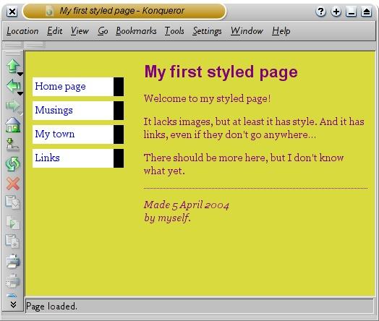
Tasks
1- Do this page
2- freecodecamp task quiz accessibility
https://www.freecodecamp.org/learn/2022/responsive-web-design/learn-accessibility-by-building-a-quiz/step-1
3- search about rgba for color property and display proberty
4- create github account (optional)

